Slide 1
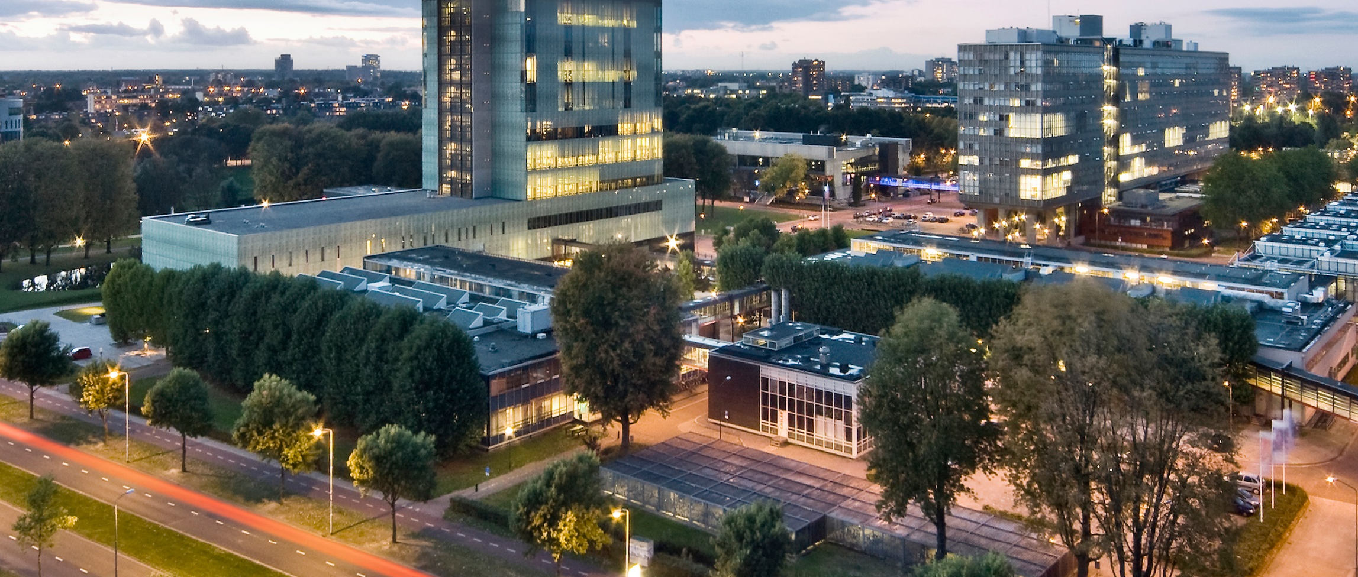
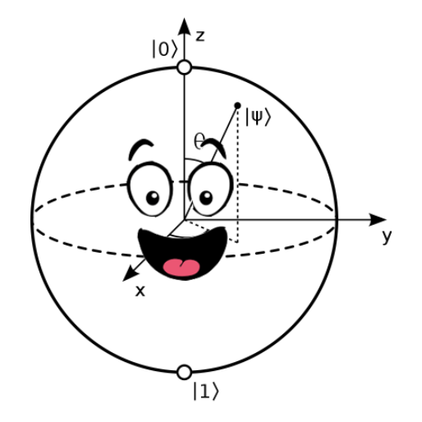
Quantum computing in the noisy intermediate-scale quantum (NISQ) era
Lecture 3: Quantum Dynamics & Simulation
Robert de Keijzer, r.j.p.t.d.keijzer@tue.nl

Slide 2
Download from: bit.ly/43blrmh
Unpack the Ottawa_QC_Wokrhsop.zip file somewhere you can access
If you don’t have it yet, download Anaconda from https://www.anaconda.com/products/distribution
When installed, open the Anaconda Prompt terminal (from your searchbar or any other way) (if you have linux or iOS, run the code below from your regular terminal)
Create a new conda environment (for instance with name “CASA_workshop”) with the command
conda create --name Ottawa_QC
5. Activate the environment using
conda activate Ottawa_QC
Install pip using:
conda install pip
7. Install packages using
pip install jupyter
pip install qutip
pip install matplotlib==3.4
8. Open Jupyter using
jupyter notebook
9. Navigate to the directory you unpacked the zip file

Slide 3
Slides can be found at: https://aiquantum.uottawa.ca/

Slide 4
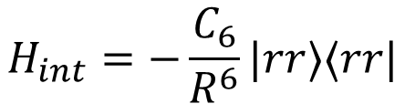
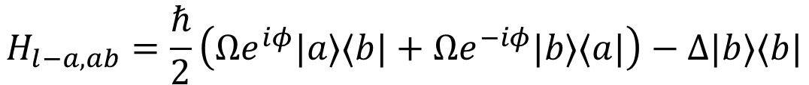
Recap: Rydberg Physics
Light atom interaction:
$$H_{l−a,ab}=\frac{ℏ}{2}\left(Ωe^{iφ}|a⟩⟨b|+Ωe^{−iφ}|b⟩⟨a|\right)−Δ|b⟩⟨b|$$
Rydberg interaction:
$$H_{int}=−\frac{C_{6}}{R^{6}}|rr⟩⟨rr|$$
Acts as detuning on $|rr⟩$ state $⇒$suppresses excitation of both atoms to $|r⟩$

Slide 5
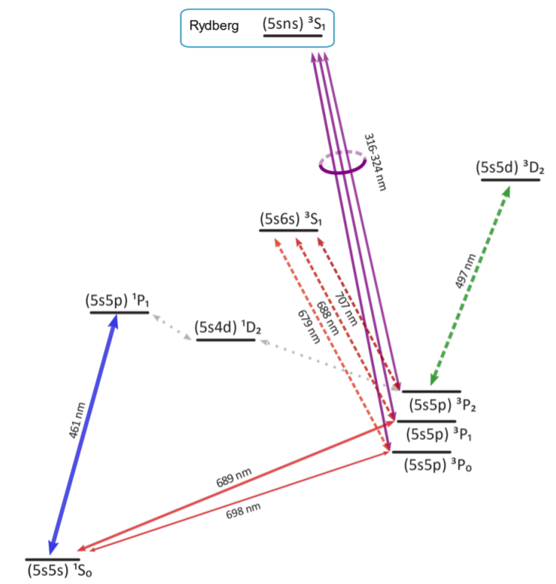
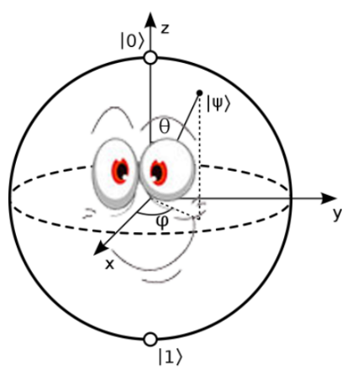
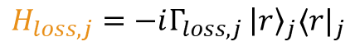
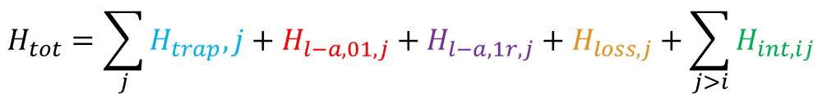
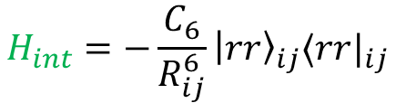
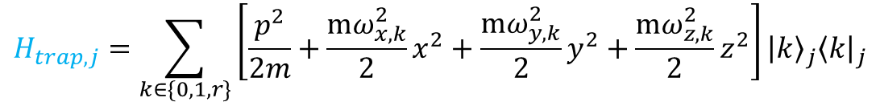
Total qubit Hamiltonian
$$H_{tot}=\sum_{j}{H_{trap},j}+H_{l−a,01,j}+H_{l−a,1r,j}+H_{loss,j}+\sum_{j>i}{H_{int,ij }}$$
$$H_{trap,j}=\sum_{k∈\{0,1,r\}}{\left[\frac{p^{2}}{2m}+\frac{mω_{x,k}^{2}}{2}x^{2}+\frac{mω_{y,k}^{2}}{2}y^{2}+\frac{mω_{z,k}^{2}}{2}z^{2}\right]}{\left|k\right\rangle }_{j}{\left\langle k\right|}_{j}$$
$$H_{l−a,01,j}=\frac{ℏ}{2}\left(Ω_{01,j}\left(t\right)e^{iφ_{01,j}\left(t\right)}{\left|0\right\rangle }_{j}⟨1|_{j}+h.c.\right)−Δ_{01,j}\left(t\right){\left|1\right\rangle }_{j}⟨1|_{j}$$
$$H_{l−a,1r,j}=\frac{ℏ}{2}\left(Ω_{1r,j}\left(t\right)e^{iφ_{1r,j}\left(t\right)}{\left|1\right\rangle }_{j}⟨r|_{j}+h.c.\right)−Δ_{1r,j}\left(t\right){\left|r\right\rangle }_{j}⟨r|_{j}$$
$$H_{int}=−\frac{C_{6}}{R_{ij}^{6}}{\left|rr\right\rangle }_{ij}⟨r{r|}_{ij}$$
$$H_{loss,j}=−iΓ_{loss,j }{\left|r\right\rangle }_{j}⟨r|_{j}$$

Slide 6
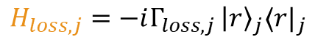

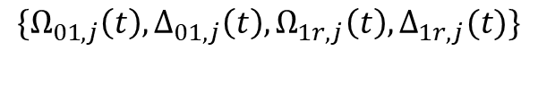
Total qubit Hamiltonian
$$H_{tot}=\sum_{j}{H_{trap},j}+H_{l−a,01,j}+H_{l−a,1r,j}+H_{loss,j}+\sum_{j>i}{H_{int,ij }}$$
$$H_{trap,j}=\sum_{k∈\{0,1,r\}}{\left[\frac{p^{2}}{2m}+\frac{mω_{x,k}^{2}}{2}x^{2}+\frac{mω_{y,k}^{2}}{2}y^{2}+\frac{mω_{z,k}^{2}}{2}z^{2}\right]}{\left|k\right\rangle }_{j}{\left\langle k\right|}_{j}$$
$$H_{l−a,01,j}=\frac{ℏ}{2}\left(Ω_{01,j}\left(t\right)e^{iφ_{01,j}\left(t\right)}{\left|0\right\rangle }_{j}⟨1|_{j}+h.c.\right)−Δ_{01,j}\left(t\right){\left|1\right\rangle }_{j}⟨1|_{j}$$
$$H_{l−a,1r,j}=\frac{ℏ}{2}\left(Ω_{1r,j}\left(t\right)e^{iφ_{1r,j}\left(t\right)}{\left|1\right\rangle }_{j}⟨r|_{j}+h.c.\right)−Δ_{1r,j}\left(t\right){\left|r\right\rangle }_{j}⟨r|_{j}$$
$$H_{int}=−\frac{C_{6}}{R_{ij}^{6}}{\left|rr\right\rangle }_{ij}⟨r{r|}_{ij}$$
$$H_{loss,j}=−iΓ_{loss,j }{\left|r\right\rangle }_{j}⟨r|_{j}$$
Controllable parameters
$$\{Ω_{01,j}\left(t\right), Δ_{01,j}\left(t\right),Ω_{1r,j}\left(t\right), Δ_{1r,j}(t)\}$$

Slide 7
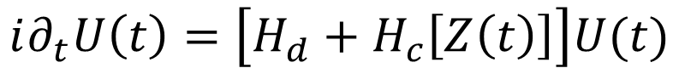
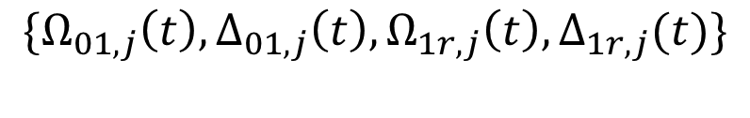
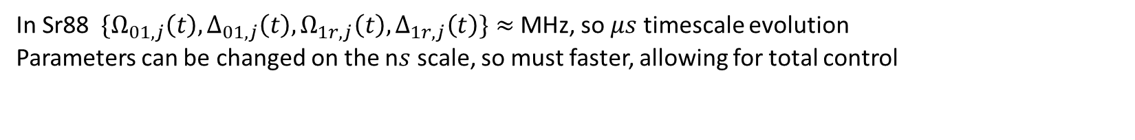
Dynamical formulation
$$\{Ω_{01,j}\left(t\right), Δ_{01,j}\left(t\right),Ω_{1r,j}\left(t\right), Δ_{1r,j}(t)\}$$
$$i∂_{t}U\left(t\right)=\left[H_{d}+H_{c}\left[Z\left(t\right)\right]\right]U(t)$$
Drift Hamiltonian: natural ‘always on’ evolution of the system
Control Hamiltonian
control of system
In Sr88 $\{Ω_{01,j}\left(t\right), Δ_{01,j}\left(t\right),Ω_{1r,j}\left(t\right), Δ_{1r,j}\left(t\right)\}≈$ MHz, so $μs$ timescale evolution
Parameters can be changed on the n$s$ scale, so must faster, allowing for total control

Slide 8
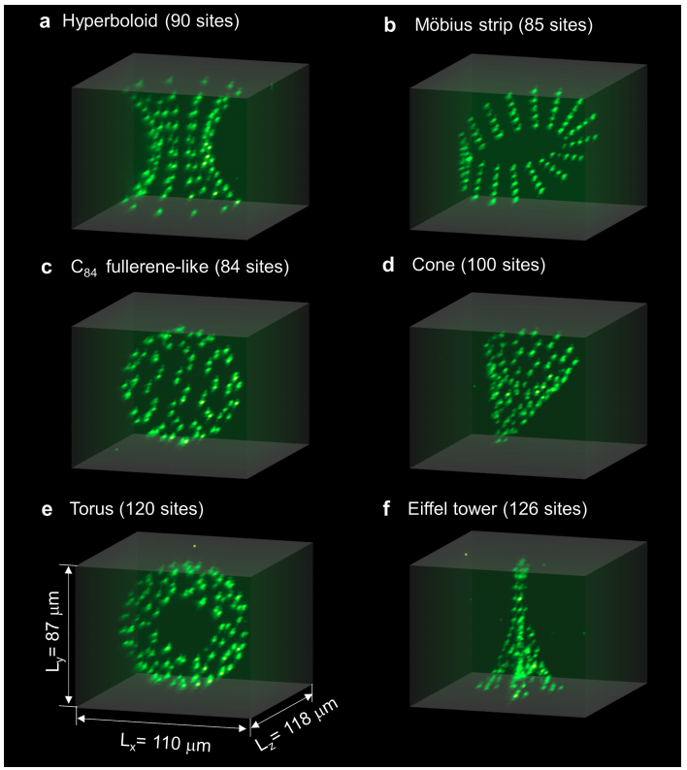
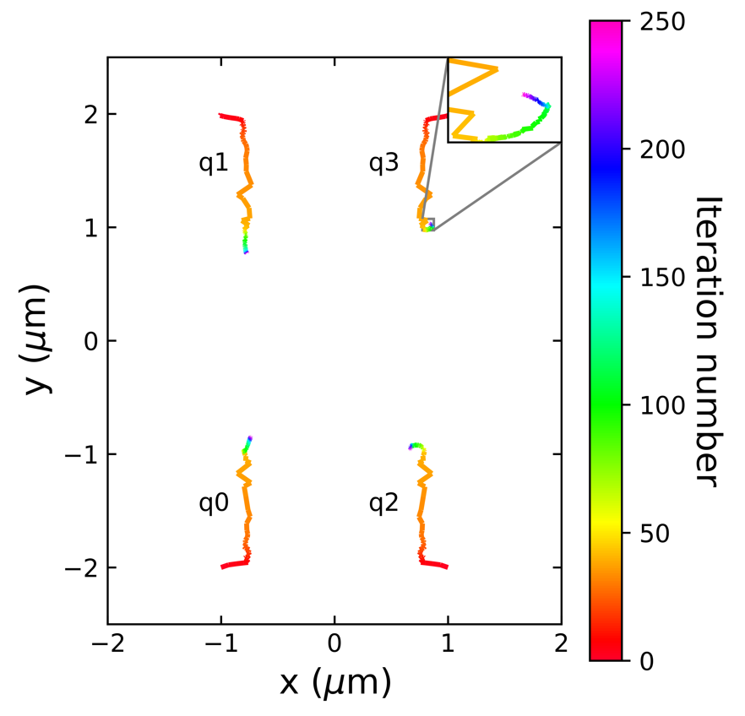
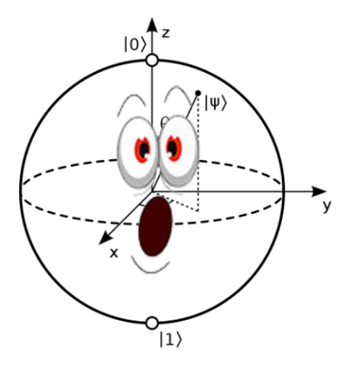
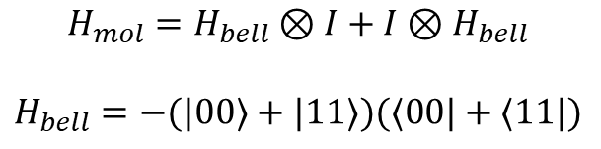

Atom positions
$$H_{int}=−\frac{C_{6}}{R_{ij}^{6}}{\left|rr\right\rangle }_{ij}⟨r{r|}_{ij}$$
Often assumed atoms are in a line or grid,
but can in principle be placed everywhere
Unique property to the Rydberg system!
Tunable interactions! Can be optimized
$$H_{mol}=H_{bell}⊗I+I⊗H_{bell}$$
$$H_{bell}=−(|00⟩+|11⟩)(⟨00|+⟨11|)$$
Source: Daniel Barredo, Vincent Lienhard, Sylvain de Leseleuc, Thierry Lahaye, and Antoine Browaeys. “Synthetic three-dimensional atomic structures assembled atom by atom.” arXiv:1712.02727, 2017.

Slide 9
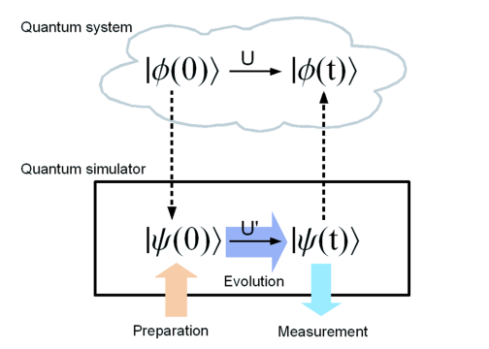
Quantum Simulation
“The rule of simulation that I would like to have is that the number of computer elements required to simulate a large physical system is only to be proportional to the space-time volume of the physical system. I don’t want to have an explosion”
(Feynman, 1982).
Quantum simulation is the simulation of a quantum system by quantum mechanical means
classical system requires exponentially many resources
Simulate evolution of inaccessible/incontrollable system by means of controllable system
Source: 10.1103/RevModPhys.86.153

Slide 10
Quantum Simulation
“The rule of simulation that I would like to have is that the number of computer elements required to simulate a large physical system is only to be proportional to the space-time volume of the physical system. I don’t want to have an explosion”
(Feynman, 1982).
Quantum simulation is the simulation of a quantum system by quantum mechanical means
classical system requires exponentially many resources
Simulate evolution of inaccessible/incontrollable system by means of controllable system
Source: 10.1103/RevModPhys.86.153

Slide 11
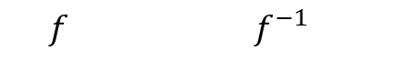
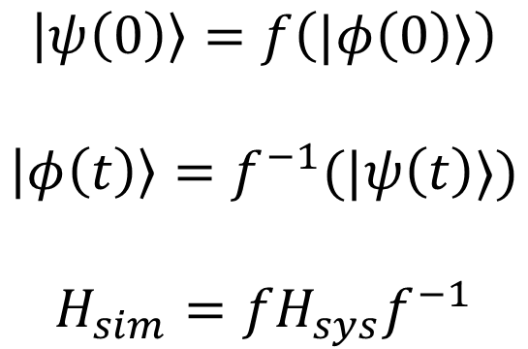
Quantum Simulation
$$\left|ψ\left(0\right)\right\rangle =f\left(|φ\left(0\right)⟩\right)$$
$$\left|φ\left(t\right)\right\rangle =f^{−1}(|ψ\left(t\right)⟩)$$
$$H_{sim}=fH_{sys}f^{−1}$$
$$f f^{−1}$$
Source: 10.1103/RevModPhys.86.153

Slide 12
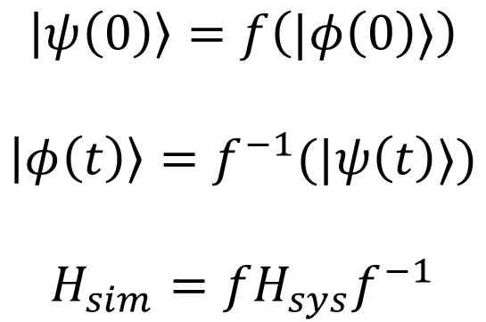
Quantum Simulation
Based on mapping between simulating system and to be analyzed system
$$\left|ψ\left(0\right)\right\rangle =f\left(|φ\left(0\right)⟩\right)$$
$$\left|φ\left(t\right)\right\rangle =f^{−1}(|ψ\left(t\right)⟩)$$
$$H_{sim}=fH_{sys}f^{−1}$$
$$f f^{−1}$$
Source: 10.1103/RevModPhys.86.153

Slide 13
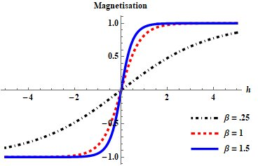
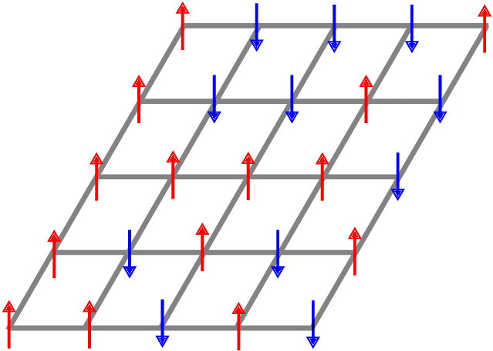
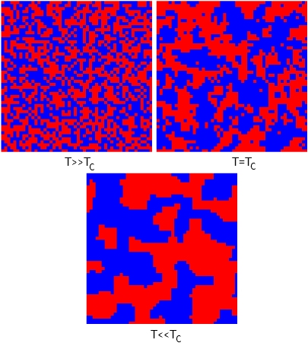

Ising Model
$$\left|↓\right\rangle$$
$$\left|↑\right\rangle$$
The textbook interacting particle system
$$H_{sys}=B_{x}\left(t\right)\sum_{k}{X_{k}}+B_{z}(t)\sum_{k}{Z_{k}}+\sum_{k≠l}{J_{kl}Z_{k}Z_{l}}$$
$$X_{k}={\frac{1}{2}(\left|↓\right\rangle }_{k}⟨↑|_{k}+{\left|↑\right\rangle }_{k}\left\langle ↓|_{k}\right), Z_{k}={\frac{1}{2}(\left|↑\right\rangle }_{k}⟨↑|_{k}−{\left|↓\right\rangle }_{k}\left\langle ↓|_{k}\right)$$

Slide 14
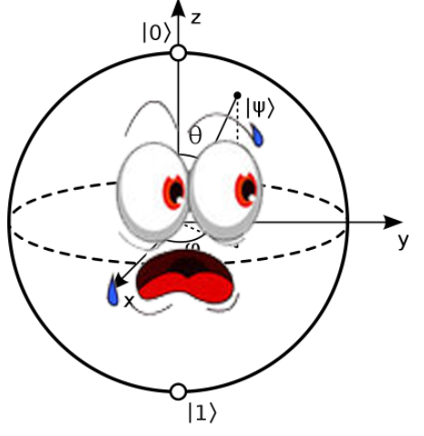
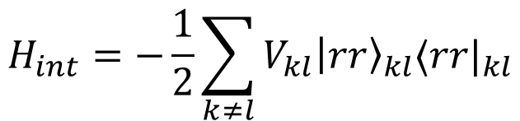

Ising model
$$H_{l−a,1r}(t)=\sum_{k}{\frac{1}{2}\left(Ω_{k}\left(t\right)e^{iφ_{k}\left(t\right)}{\left|1\right\rangle }_{k}⟨r|_{k}+Ω_{k}(t)e^{−iφ_{k}(t)}{\left|r\right\rangle }_{k}⟨1|_{k}\right)−Δ_{k}(t){\left|r\right\rangle }_{k}⟨r|_{k}}$$
$$H_{int}=−\frac{1}{2}\sum_{k≠l}{V_{kl}{\left|rr\right\rangle }_{kl}⟨rr|_{kl}}$$
$${\left|1\right\rangle }_{k}={\left|↓\right\rangle }_{k},{\left|r\right\rangle }_{k}={\left|↑\right\rangle }_{k}, X_{k}={\frac{1}{2}(\left|1\right\rangle }_{k}⟨r|_{k}+{\left|r\right\rangle }_{k}\left\langle 1|_{k}\right), Z_{k}={\frac{1}{2}(\left|r\right\rangle }_{k}⟨r|_{k}−{\left|1\right\rangle }_{k}\left\langle 1|_{k}\right)$$
Rydberg
Ising
$$H_{sim}=Ω\left(t\right)\sum_{k}{X_{k}}+\sum_{k}{\left[C_{k}−Δ(t)\right]Z_{k}}+\sum_{k≠l}{\frac{V_{kl}}{2}Z_{k}Z_{l}}, C_{k}=\sum_{l}{\left(1−δ_{kl}\right)}\frac{V_{kl}}{2}$$
$$f$$
$$H_{sys}=B_{x}\left(t\right)\sum_{k}{X_{k}}+B_{z}(t)\sum_{k}{Z_{k}}+\sum_{k≠l}{J_{kl}Z_{k}Z_{l}}$$
For large systems, almost constant in k

Slide 15
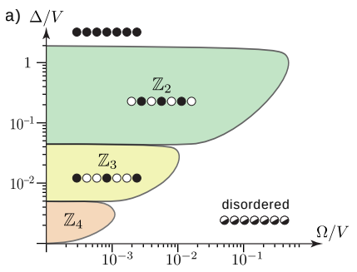
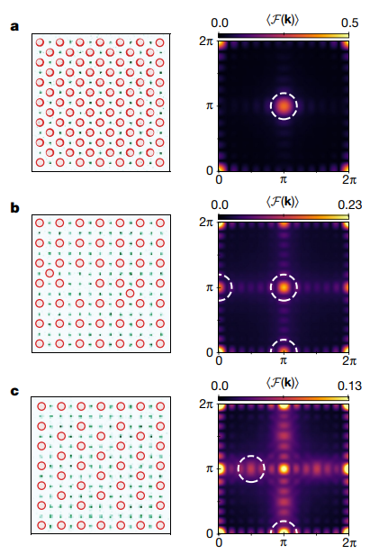

Ising model (gr-qubits)
Rydberg
Ising
$$H_{sim}=Ω\left(t\right)\sum_{k}{X_{k}}+\sum_{k}{\left[C_{k}−Δ(t)\right]Z_{k}}+\sum_{k≠l}{\frac{V_{kl}}{2}Z_{k}Z_{l}},$$
$$f$$
$$H_{sys}=B_{x}\left(t\right)\sum_{k}{X_{k}}+B_{z}(t)\sum_{k}{Z_{k}}+\sum_{k≠l}{J_{kl}Z_{k}Z_{l}}$$
Source: (MW)
Source: Nature volume 595, pages227–232 (2021)

Slide 16


JUPYTER NOTEBOOK TIME

Slide 17
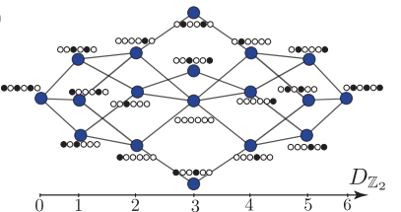
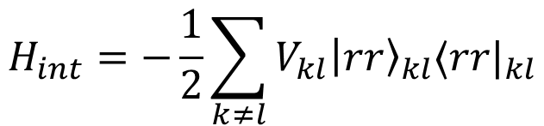
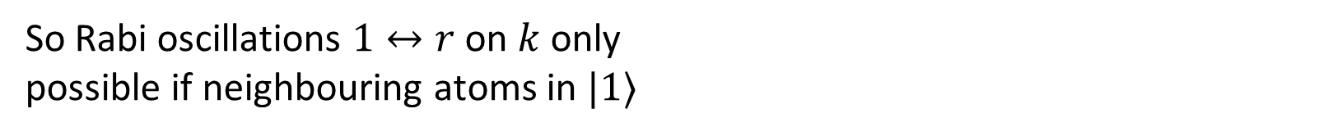
PXP model
$$H_{l−a,1r}(t)=\sum_{k}{\frac{1}{2}\left(Ω_{k}\left(t\right)e^{iφ_{k}\left(t\right)}{\left|1\right\rangle }_{k}⟨r|_{k}+Ω_{k}(t)e^{−iφ_{k}(t)}{\left|r\right\rangle }_{k}⟨1|_{k}\right)−Δ_{k}(t){\left|r\right\rangle }_{k}⟨r|_{k}}$$
$$H_{int}=−\frac{1}{2}\sum_{k≠l}{V_{kl}{\left|rr\right\rangle }_{kl}⟨rr|_{kl}}$$
Consider line of atoms, $Δ_{k}=0$ and $V_{kl}≈0$ for $\left|k−l\right|>1$, Rydberg blockade will give us
$$H_{sim}=Ω\left(t\right)\sum_{k}{{P_{k−1}X}_{k}P_{k+1}}, P_{k}={\left|1\right\rangle }_{k}{\left\langle 1\right|}_{k}$$
So Rabi oscillations $1↔r$ on $k$ only
possible if neighbouring atoms in $|1⟩$
Source: Phys. Rev. B, 98, 155134 (2018)

Slide 18
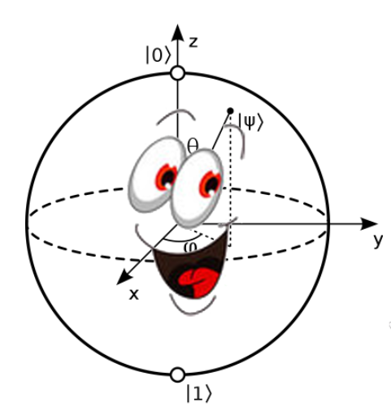
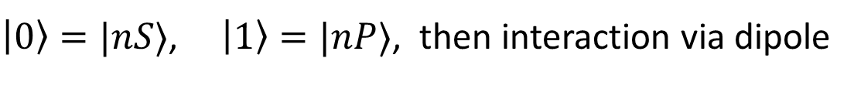
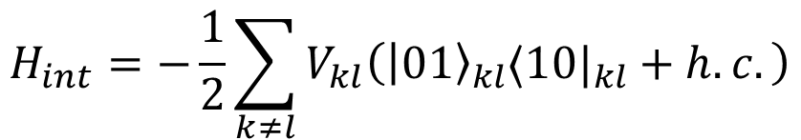
XY model (dipole interaction)
$\left|0\right\rangle =|nS⟩$, $\left|1\right\rangle =|nP⟩$, then interaction via dipole
$$H_{l−a,1r}(t)=\sum_{k}{\frac{1}{2}\left(Ω_{k}\left(t\right)e^{iφ_{k}\left(t\right)}{\left|0\right\rangle }_{k}⟨1|_{k}+Ω_{k}(t)e^{−iφ_{k}(t)}{\left|1\right\rangle }_{k}⟨0|_{k}\right)−Δ_{k}(t){\left|r\right\rangle }_{k}⟨r|_{k}}$$
$$H_{int}=−\frac{1}{2}\sum_{k≠l}{V_{kl}\left({\left|01\right\rangle }_{kl}⟨10|_{kl}+h.c.\right)}$$
Rydberg
$$H_{sim}=Ω\left(t\right)\sum_{k}{X_{k}}+Δ\left(t\right)\sum_{k}{Z_{k}}+\sum_{k≠l}{\frac{V_{kl}}{4}(X_{k}X_{l}+Y_{k}Y_{l})}$$

Slide 19
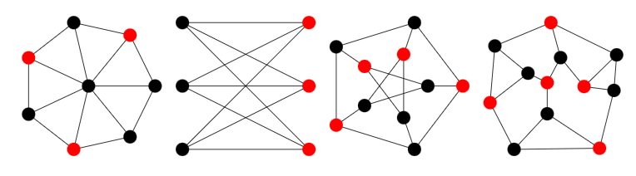
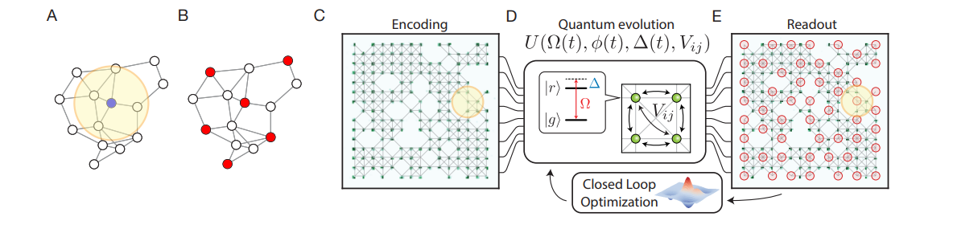
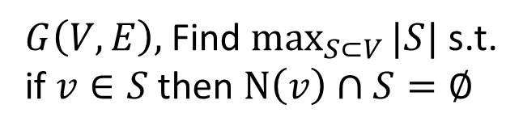
Maximal independent set problem
$G\left(V,E\right),$Find $\max_{S⊂V}{|S|}$ s.t. if $v∈S$ then $N\left(v\right)∩S=∅$
i.e. find the maximal set of atoms that don’t
have neighbours within the set. Perfect
for Rydberg blockade!
Source: arXiv:2202.09372

Slide 20
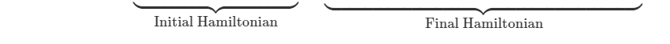
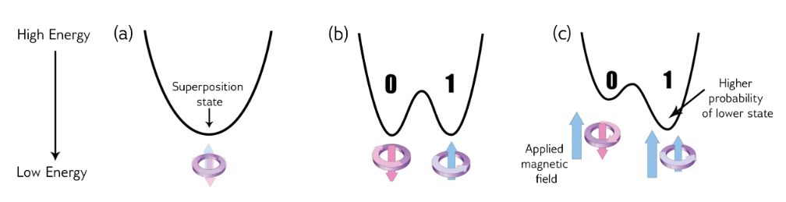
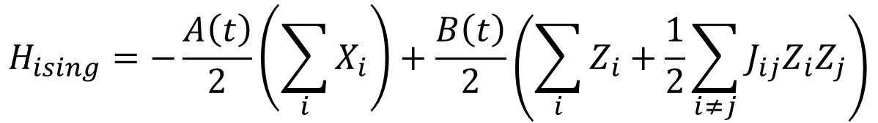
Quantum Annealing
$$H_{ising}=−\frac{A\left(t\right)}{2}\left(\sum_{i}{X_{i}}\right)+\frac{B\left(t\right)}{2}\left(\sum_{i}{Z_{i}+\frac{1}{2}\sum_{i≠j}{J_{ij}Z_{i}Z_{j}}}\right)$$
Adiabatic theorem: for slow enough evolution, ground state will be maintained
Source: https://docs.dwavesys.com/docs/latest/c_gs_2.html

Slide 21
D-Wave
$$H_{ising}=−\frac{A\left(t\right)}{2}\left(\sum_{i}{X_{i}}\right)+\frac{B\left(t\right)}{2}\left(\sum_{i}{Z_{i}+\frac{1}{2}\sum_{i≠j}{J_{ij}Z_{i}Z_{j}}}\right)$$
Adiabatic theorem: for slow enough evolution, ground state will be maintained
Source: https://docs.dwavesys.com/docs/latest/c_gs_2.html

Slide 22
JUPYTER NOTEBOOK TIME

Slide 23
Single Qubit gates on Rydberg
For full control: X, Y and Z rotations
$$H_{l−a,01}(t)=\frac{1}{2}\left(Ω(t)e^{iφ\left(t\right)}|0⟩⟨1|+Ω(t)e^{−iφ(t)}|1⟩⟨0|\right)−Δ(t)|1⟩⟨1|$$
$Ω\left(t\right)=0, Δ\left(t\right)=Δ, φ\left(t\right)=0: U\left(t\right)=\exp\left(−iΔ\left(\begin{matrix}0 & 0 \\ 0 & 1\end{matrix}\right)t\right)=$ $\left(\begin{matrix}1 & 0 \\ 0 & e^{−iΔt}\end{matrix}\right)$
$Ω\left(t\right)=Ω, Δ\left(t\right)=0, φ\left(t\right)=0: U\left(t\right)=\exp\left(−iΩ\left(\begin{matrix}0 & 1 \\ 1 & 0\end{matrix}\right)t\right)=$ $\left(\begin{matrix}\cos{(Ωt)} & −i\sin{(Ωt)} \\ −i sin⁡(Ωt) & \cos{(Ωt)}\end{matrix}\right)$

Slide 24
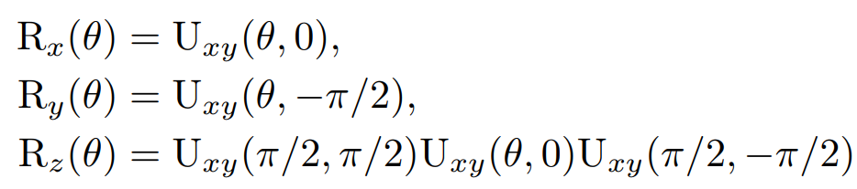

Single Qubit gates on Rydberg
For full control: X, Y and Z rotations
$$H_{l−a,01}(t)=\frac{1}{2}\left(Ω(t)e^{iφ\left(t\right)}|0⟩⟨1|+Ω(t)e^{−iφ(t)}|1⟩⟨0|\right)−Δ(t)|1⟩⟨1|$$
$$Ω\left(t\right)=Ω, Δ\left(t\right)=0, φ\left(t\right)=φ:$$
$U_{xy}\left(t\right)=\exp\left(−iΩ\left(\begin{matrix}0 & e^{iφ} \\ e^{−iφ} & 0\end{matrix}\right)t\right)=$ $\left(\begin{matrix}\cos{(θ)} & −i\sin{(θ)e^{iφ}} \\ −i sin⁡(θ)e^{−iφ} & \cos{(θ)}\end{matrix}\right)$
$$θ:=Ωt$$

Slide 25
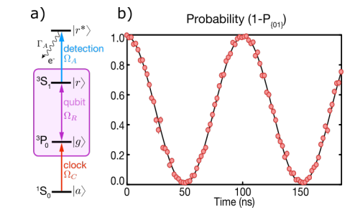
Experimental Implementation of X gate
Source: Nat. Phys. 16, 857-861 (2020)

Slide 26
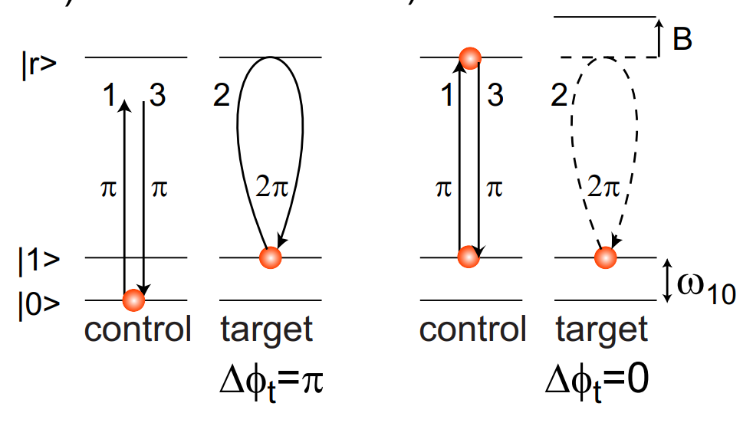
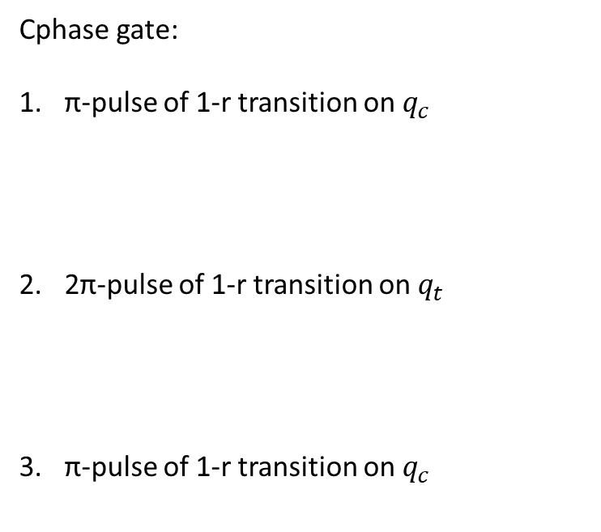
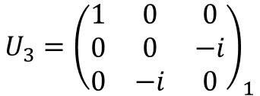
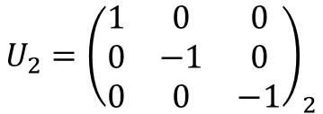
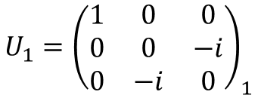
Two qubit gates on Rydberg
Cphase gate:
π-pulse of 1-r transition on $q_{c}$
2π-pulse of 1-r transition on $q_{t}$
π-pulse of 1-r transition on $q_{c}$
$${U_{1}=\left(\begin{matrix}1 & 0 & 0 \\ 0 & 0 & −i \\ 0 & −i & 0\end{matrix}\right)}_{1}$$
$${U_{2}=\left(\begin{matrix}1 & 0 & 0 \\ 0 & −1 & 0 \\ 0 & 0 & −1\end{matrix}\right)}_{2}$$
$${U_{3}=\left(\begin{matrix}1 & 0 & 0 \\ 0 & 0 & −i \\ 0 & −i & 0\end{matrix}\right)}_{1}$$

Slide 27
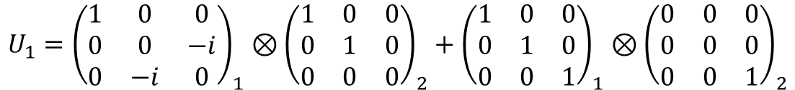




Two qubit gates on Rydberg
Cphase gate:
π-pulse of 1-r transition on $q_{c}$
2π-pulse of 1-r transition on $q_{t}$
π-pulse of 1-r transition on $q_{c}$
$${U_{1}=\left(\begin{matrix}1 & 0 & 0 \\ 0 & 0 & −i \\ 0 & −i & 0\end{matrix}\right)}_{1}⊗{\left(\begin{matrix}1 & 0 & 0 \\ 0 & 1 & 0 \\ 0 & 0 & 0\end{matrix}\right)}_{2}+{\left(\begin{matrix}1 & 0 & 0 \\ 0 & 1 & 0 \\ 0 & 0 & 1\end{matrix}\right)}_{1}⊗{\left(\begin{matrix}0 & 0 & 0 \\ 0 & 0 & 0 \\ 0 & 0 & 1\end{matrix}\right)}_{2}$$
$$U_{3}U_{2}U_{1}=\left(\begin{matrix}\begin{matrix}1 & 0 \\ 0 & −1\end{matrix} & \begin{matrix} 0 & 0 \\ 0 & 0\end{matrix} \\ \begin{matrix}0 & 0 \\ 0 & 0\end{matrix} & \begin{matrix}−1 & 0 \\ 0 & −1\end{matrix}\end{matrix}\right)$$
$${U_{2}={\left(\begin{matrix}1 & 0 & 0 \\ 0 & 1 & 0 \\ 0 & 0 & 0\end{matrix}\right)}_{1}⊗\left(\begin{matrix}1 & 0 & 0 \\ 0 & −1 & 0 \\ 0 & 0 & −1\end{matrix}\right)}_{2}+{{\left(\begin{matrix}0 & 0 & 0 \\ 0 & 0 & 0 \\ 0 & 0 & 1\end{matrix}\right)}_{1}⊗\left(\begin{matrix}1 & 0 & 0 \\ 0 & 1 & 0 \\ 0 & 0 & 1\end{matrix}\right)}_{2}$$
$${U_{3}=\left(\begin{matrix}1 & 0 & 0 \\ 0 & 0 & −i \\ 0 & −i & 0\end{matrix}\right)}_{1}⊗{\left(\begin{matrix}1 & 0 & 0 \\ 0 & 1 & 0 \\ 0 & 0 & 0\end{matrix}\right)}_{2}+{\left(\begin{matrix}1 & 0 & 0 \\ 0 & 1 & 0 \\ 0 & 0 & 1\end{matrix}\right)}_{1}⊗{\left(\begin{matrix}0 & 0 & 0 \\ 0 & 0 & 0 \\ 0 & 0 & 1\end{matrix}\right)}_{2}$$

Slide 28


Two qubit gates on Rydberg
$$CU_{xy}\left(θ,φ\right)=\exp\left(−i\left(H_{l−a,1r,2}+H_{int}\right)t\right)=\left(\begin{matrix}\begin{matrix}\cos{(θ)} & −i\sin{(θ)e^{iφ}} \\ −i sin⁡(θ)e^{−iφ} & \cos{(θ)}\end{matrix} & \begin{matrix}0 & 0 \\ 0 & 0\end{matrix} \\ \begin{matrix}0 & 0 \\ 0 & 0\end{matrix} & \begin{matrix}1 & 0 \\ 0 & 1\end{matrix}\end{matrix}\right)$$
$$V≫Ω, V=\frac{2πm}{t}, θ=Ωt, Δ=0$$
$$CNOT: θ=\frac{π}{2}, φ=−\frac{π}{2}$$
Can create universal gate set!

Slide 29



Two qubit gates on Rydberg
Source: (MW)

Slide 30
JUPYTER NOTEBOOK TIME

